Slide 1
História da Gestão
1a - 1

Slide 2
Objetivos
Descrever alguns dos contributos mais antigos.
Explicar as várias teorias da abordagem clássica.
Descrever o desenvolvimento e as aplicações da abordagem comportamental.
Descrever a abordagem quantitativa.
Explicar as várias teorias da abordagem contemporânea.

Slide 3
Contributos mais antigos
Grandes obras da antiguidade – Pirâmides do Egito e muralha da China – necessitaram de Planeamento, Organização, Direção e Controlo.
Estaleiros de Veneza (sec. XV) – Utilizaram linhas de montagem, sistemas de contabilidade, e funções de gestão de pessoas.
Notes:
The Egyptian pyramids and the Great Wall of China are proof that projects of tremendous scope, employing tens of thousands of people, were completed in ancient times.

Slide 4
Contributos mais antigos
Adam Smith (A Riqueza das Nações, 1776)
  Divisão / especialização do trabalho – divisão do trabalho em tarefas simples e repetitivas.
Notes:
In 1776, Adam Smith published The Wealth of Nations, in which he argued the economic advantages that organizations and society would gain from the division of labor (or job specialization)—that is, breaking down jobs into narrow and repetitive tasks.
Starting in the late eighteenth century when machine power was substituted for human power, a point in history known as the industrial revolution, it became more economical to manufacture goods in factories rather than at home. These large efficient factories needed someone to forecast demand, ensure that enough material was on hand to make products, assign tasks to people, direct daily activities, and so forth.

Slide 5
Contributos mais antigos
Revolução Industrial
  Substitui o trabalho humano por máquinas.
  Levou ao aparecimento de grandes fábricas e à necessidade de formalizar a gestão.
Notes:
In 1776, Adam Smith published The Wealth of Nations, in which he argued the economic advantages that organizations and society would gain from the division of labor (or job specialization)—that is, breaking down jobs into narrow and repetitive tasks.
Starting in the late eighteenth century when machine power was substituted for human power, a point in history known as the industrial revolution, it became more economical to manufacture goods in factories rather than at home. These large efficient factories needed someone to forecast demand, ensure that enough material was on hand to make products, assign tasks to people, direct daily activities, and so forth.

Slide 6
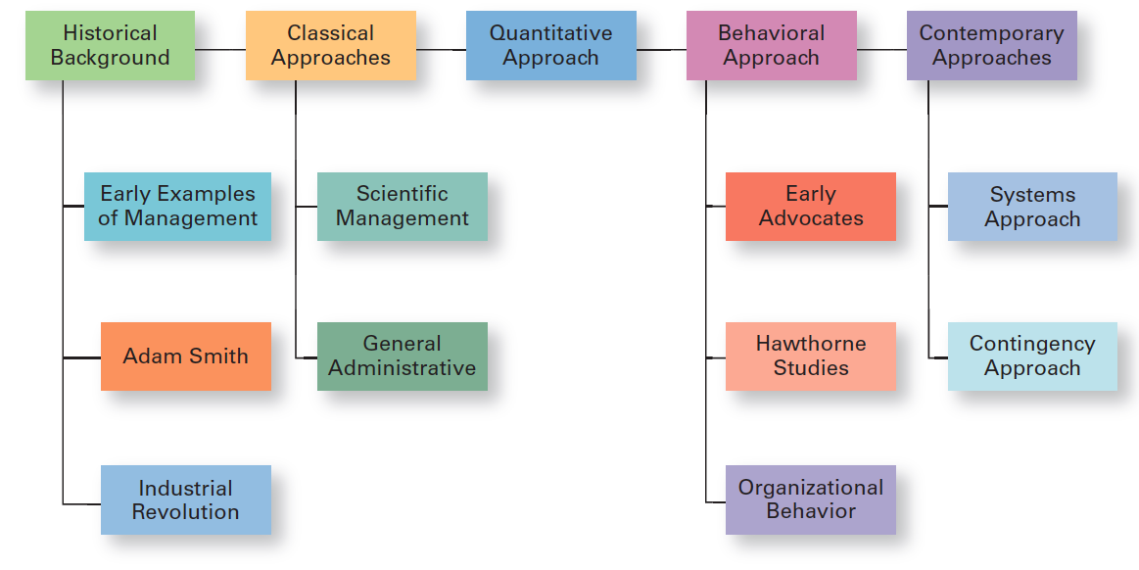
Figura HG-1
Principais abordagens na História da Gestão
Notes:
In this module, we’ll look at four major approaches to management theory: classical, behavioral, quantitative, and contemporary. (See Exhibit MH-1 above.)

Slide 7
Abordagem clássica
Abordagem Clássica - Designa os primeiros estudos na área da gestão e enfatiza a racionalidade e o tornar as organizações e os trabalhadores o mais eficientes possível.
Inclui:
  A Gestão Científica (Taylor e os Gilbreth)
  A Teoria Administrativa (Fayol e Weber)
Notes:
The first studies of management, often called the classical approach, emphasized rationality and making organizations and workers as efficient as possible. Two major theories comprise the classical approach: scientific management and general administrative theory. The two most important contributors to scientific management theory were Frederick W. Taylor and the husband-wife team of Frank and Lillian Gilbreth. The two most important contributors to general administrative theory were Henri Fayol and Max Weber. Let’s take a look at each of these important figures in management history.

Slide 8
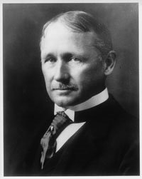
Frederick Winslow Taylor
  “Pai” da gestão científica – abordagem baseada na utilização do método científico, para encontrar o “one best way” para realizar cada tarefa (tempos, movimentos, equipamentos).
  O seu trabalho na Midvale Steel e na Bethlehem Steel estimulou o seu interesse pelo desenvolvimento da eficiência.
  A experiência do carregamento do ferro de gusa, ilustra bem a sua preocupação e os métodos utilizados – a produtividade aumentou 200%.
Notes:
If you had to pinpoint when modern management theory was born, 1911 might be a good choice. That was when Frederick Winslow Taylor’s Principles of Scientific Management was published. Its contents were widely embraced by managers around the world. Taylor’s book described the theory of scientific management – the use of scientific methods to define the “one best way” for a job to be done.

Slide 9
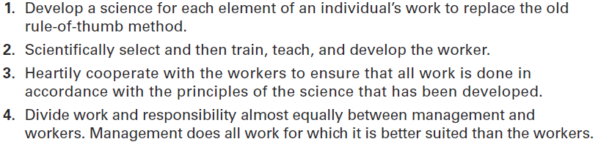
Figura HG-2
Princípios de Taylor
Notes:
Taylor’s experiences led him to define clear guidelines for improving production efficiency. He argued that these four principles of management (see Exhibit MH-2 above) would result in prosperity for both workers and managers.

Slide 10
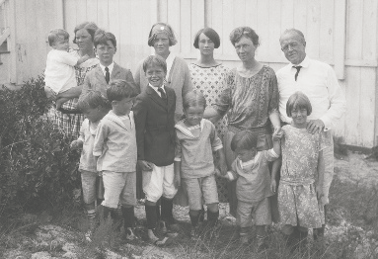
Frank E Lillian Gilbreth
Foram os primeiros a utilizar filmes para estudar movimentos das mãos e do corpo.
Conhecidos pela redução do número de movimentos necessários para realizar uma tarefa.
  Therbligs - esquema de classificação de 17 movimentos essenciais
(ex.: agarrar, puxar, empurrar).
Notes:
Taylor’s most prominent followers were Frank and Lillian Gilbreth. Frank and his wife Lillian, a psychologist, studied work to eliminate inefficient hand-and-body motions. The Gilbreths also experimented with the design and use of the proper tools and equipment for optimizing work performance.
The Gilbreths also devised a classification scheme to label 17 basic hand motions (such as search, grasp, hold), which they called therbligs (Gilbreth spelled backward with the th transposed). This scheme gave the Gilbreths a more precise way of analyzing a worker’s exact hand movements.

Slide 11
Teoria Administrativa
Teoria administrativa - Abordagem que se focaliza em identificar as boas práticas de gestão.
Fayol
- Focaliza-se nas atividades dos gestores
- Identifica 14 princípios de gestão
Weber
- Desenvolve a teoria das estruturas de autoridade e das relações de autoridade.
- Descreve a organização ideal como uma burocracia.
Notes:
General administrative theory focused more on what managers do and what constituted good management practice.

Slide 12
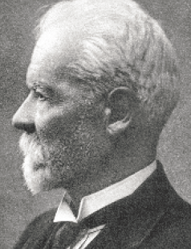
Henri Fayol
Princípios de gestão
Regras fundamentais da gestão, que poderiam ser aplicadas em todas as organizações e ensinadas nas escolas.
Notes:
Henri Fayol described the practice of management as something distinct from accounting, finance, production, distribution, and other typical business functions. His belief that management was an activity common to all business endeavors, government, and even the home, led him to develop 14 principles of management—fundamental rules of management that could be applied to all organizational situations and taught in schools. These principles are shown in Exhibit MH-3.

Slide 13
14 princípios de fayol
Divisão do trabalho
Autoridade
Disciplina
Unidade de Comando
Unidade de Direção
Subordinação dos interesses individuais aos interesses gerais
Remuneração (justa)
Centralização das decisões
Linha de comando (Cadeia escalar)
Ordem
Equidade (Justiça)
Estabilidade do pessoal
Iniciativa
Espírito de equipa

Slide 14
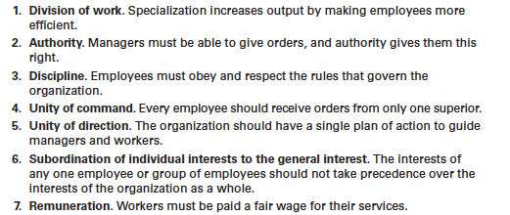
Figura hG-3
14 Princípios de Fayol

Slide 15
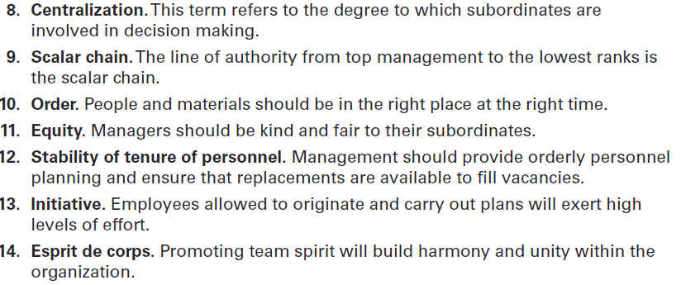
Figura HG-3
14 PrincÍpios de Fayol (cont.)

Slide 16
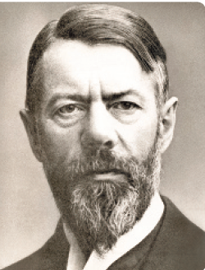
Max Weber
Burocracia
Forma de organização caracterizada pela divisão do trabalho, hierarquia bem definida, regras e procedimentos detalhados e relações impessoais.
Notes:
Max Weber (pronounced VAY-ber) was a German sociologist who studied organizations. Writing in the early 1900s, he developed a theory of authority structures and relations based on an ideal type of organization he called a bureaucracy—a form of organization characterized by division of labor, a clearly defined hierarchy, detailed rules and regulations, and impersonal relationships. (See Exhibit MH-4.)

Slide 17
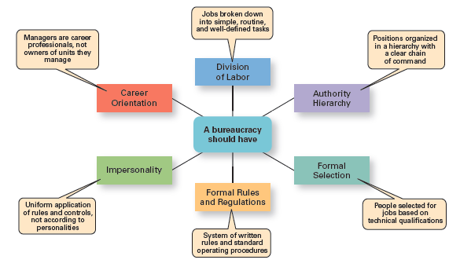
Figura HG-4
CaraterÍsticAs da burocracia de weber

Slide 18
Abordagem comportamental
Abordagem comportamental - Decorre de críticas à visão mecanicista do ser humano, das abordagens anteriores. Reconhece as pessoas como o recurso mais importante das organizações.
Comportamento Organizacional (OB) - Estudo das ações das pessoas em contexto organizacional / de trabalho.
Notes:
The field of study that researches the actions (behavior) of people at work is called organizational behavior (OB). Much of what managers do today when managing people—motivating, leading, building trust, working with a team, managing conflict, and so forth—has come out of OB research.
Although a number of individuals in the early twentieth century recognized the importance of people to an organization’s success, four stand out as early advocates of the OB approach: Robert Owen, Hugo Munsterberg, Mary Parker Follett, and Chester Barnard. Their contributions were varied and distinct, yet all believed that people were the most important asset of the organization and should be managed accordingly.

Slide 19
Abordagem Comportamental
Percursores desta abordagem (i.e. OB)
  Robert Owen
  Hugo Munsterberg
  Mary Parker Follett
  Chester Barnard
Elton Mayo contribuiu fortemente para esta abordagem, através dos estudos de Hawthorne.

Slide 20
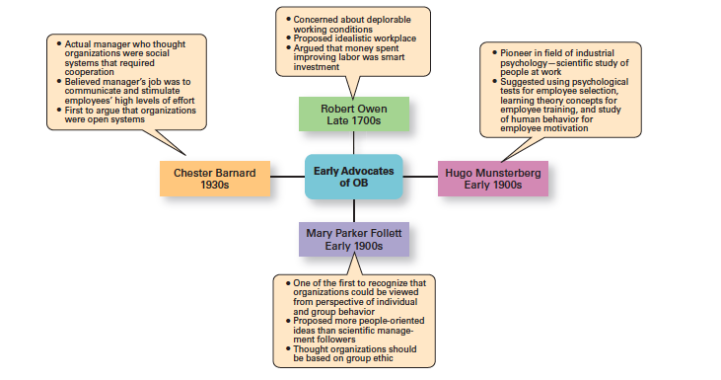
Figura HG-5
Percursores do Comportamento Organizacional
Notes:
Exhibit MH- 5 summarizes each individual’s most important ideas.

Slide 21
Estudos de Hawthorne
Estudos de Hawthorne
Estudos na fábrica da Western Electric nas décadas de 1920 e 1930, liderados por Elton Mayo. Trazem novas contribuições no que diz respeito ao comportamento individual e em grupo.
Notes:
Scholars generally agree that the Hawthorne Studies had a game-changing impact on management beliefs about the role of people in organizations. Elton Mayo conducted the Hawthorne Studies, a series of studies during the 1920s and 1930s that provided new insights into individual and group behavior. The studies concluded that people’s behavior and attitudes are closely related, that group factors significantly affect individual behavior, that group standards establish individual worker output, and that money is less a factor in determining output than group standards, group attitudes, and security. These conclusions led to a new emphasis on the human behavior factor in the management of organizations.

Slide 22
Estudos de Hawthorne
Experiência: Analisar o impacto da iluminação e dos incentivos salariais na produtividade.
Resultados: A produtividade aumentava quaisquer que fossem as mudanças nas condições de iluminação. Os incentivos remuneratórios não tinham grande impacto nos resultados.
Conclusão: Reconhecimento individual e sentimento de pertença ao grupo aumentam a produtividade.

Slide 23
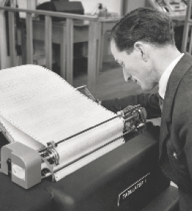
Abordagem quantitativa
Utilização de técnicas quantitativas para melhorar a tomada de decisão
Notes:
The quantitative approach is the use of quantitative techniques to improve decision making. This approach also is known as management science. The quantitative approach evolved from mathematical and statistical solutions developed for military problems during World War II. After the war was over, many of these techniques used for military problems were applied to businesses.

Slide 24
Abordagem quantitativa
Também conhecida como investigação operacional.
Tem origem nos modelos matemáticos e estatísticos desenvolvidos para resolver problemas militares na Segunda Guerra Mundial.

Slide 25
Abordagem quantitativa
Esses métodos foram posteriormente aplicados na indústria privada (ex.: o grupo militar Whiz Kids usou métodos quantitativos para melhorar a tomada de decisão na Ford nos anos 40).
Atualmente estes métodos são largamente aplicados sobretudo para o planeamento e controlo.

Slide 26
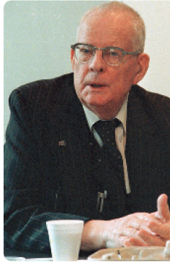
Total Quality Management (TQM)
Gestão da Qualidade Total (TQM)
Uma filosofia de gestão que se baseia na melhoria contínua e numa pronta resposta às necessidades e expectativas dos clientes.
1a - 26
Notes:
Another area where quantitative techniques are used frequently is in total quality management. A quality revolution swept through both the business and public sectors in the 1980s and 1990s. It was inspired by a small group of quality experts; the most famous was W. Edwards Deming (pictured above) and Joseph M. Juran. The ideas and techniques they advocated in the 1950s had few supporters in the United States but were enthusiastically embraced by Japanese organizations. As Japanese manufacturers began beating U.S. competitors in quality comparisons, however, Western managers soon took a more serious look at Deming’s and Juran’s ideas, which became the basis for today’s quality management programs.
Total quality management, or TQM, is a management philosophy devoted to continual improvement and responding to customer needs and expectations. (See Exhibit MH-6.) The term customer includes anyone who interacts with the organization’s product or services, internally or externally. It encompasses employees and suppliers as well as the people who purchase the organization’s goods or services.

Slide 27
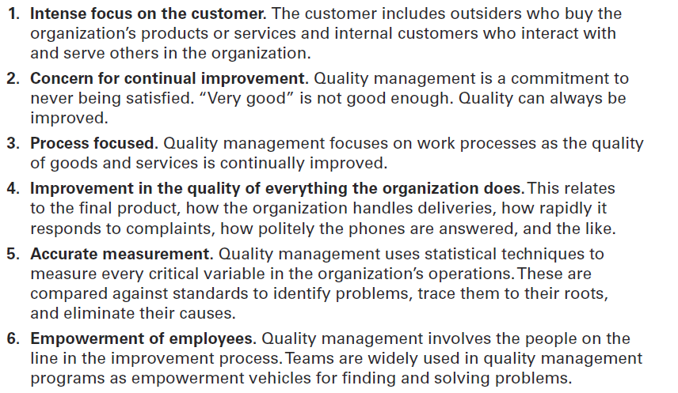
Figura HG-6
What Is Quality Management?

Slide 28
Abordagens contemporâneas
Abordagem sistémica
Abordagem contingencial

Slide 29
Abordagem sistémica
Sistema
Conjunto de partes inter-relacionadas e interdependentes que funcionam como um todo.
Notes:
Most of these earlier approaches focused on managers’ concerns inside the organization. Starting in the 1960s, management researchers began to look at what was happening in the external environment outside the boundaries of the organization. Two contemporary management perspectives— systems and contingency—are part of this approach. Systems theory is a basic theory in the physical sciences, but had never been applied to organized human efforts.
A system is a set of interrelated and interdependent parts arranged in a manner that produces a unified whole. The two basic types of systems are closed and open. Closed systems are not influenced by and do not interact with their environment. In contrast, open systems are influenced by and do interact with their environment. Today, when we describe organizations as systems, we mean open systems.

Slide 30
Abordagem sistémica
Sistema fechado
Sistema que não interage com o ambiente e que não é influenciado por ele.
Sistema aberto
Sistema que interage com o ambiente.
Notes:
Most of these earlier approaches focused on managers’ concerns inside the organization. Starting in the 1960s, management researchers began to look at what was happening in the external environment outside the boundaries of the organization. Two contemporary management perspectives— systems and contingency—are part of this approach. Systems theory is a basic theory in the physical sciences, but had never been applied to organized human efforts.
A system is a set of interrelated and interdependent parts arranged in a manner that produces a unified whole. The two basic types of systems are closed and open. Closed systems are not influenced by and do not interact with their environment. In contrast, open systems are influenced by and do interact with their environment. Today, when we describe organizations as systems, we mean open systems.

Slide 31
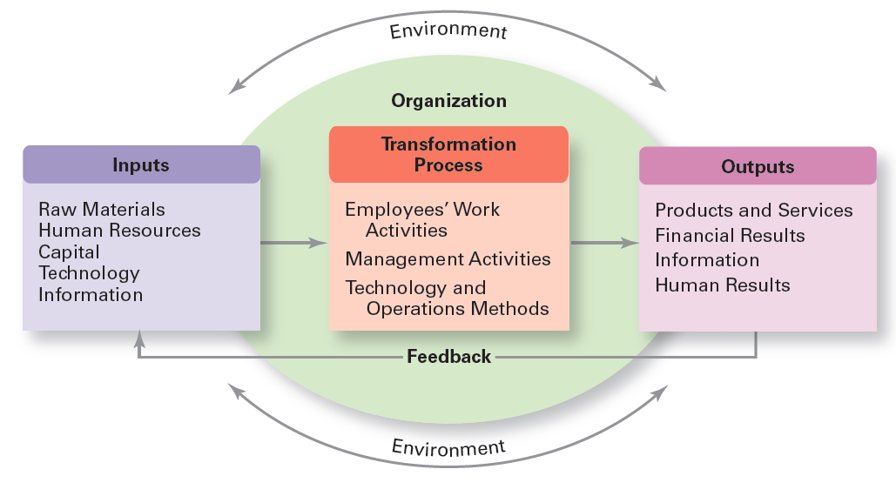
Figura HG-7
Organização como um Sistema aberto
Notes:
Exhibit MH-7 shows a diagram of an organization from an open systems’ perspective.

Slide 32
Abordagem sistémica
Os gestores devem ter em conta que as decisões e ações numa parte da organização têm consequências em outra partes.
Os gestores devem reconhecer que as organizações necessitam, e são afetadas, por fatores com origem no ambiente externo.

Slide 33
Abordagem contingencial
Também conhecida como abordagem situacional.
Reconhece que diferentes organizações necessitam diferentes modelos de gestão, ou seja, o “one best way” não existe.
Notes:
Different and changing situations require managers to use different approaches and techniques. The contingency approach (sometimes called the situational approach) says that organizations are different, face different situations (contingencies), and require different ways of managing.

Slide 34
Abordagem contingencial
Os gestores devem reconhecer as variáveis situacionais para que, depois, possam identificar as práticas de gestão mais adequadas.
Exemplos de variáveis situacionais:
Tamanho, tecnologia, grau de incerteza ambiental, diferenças individuais dos trabalhadores (educação, personalidade, etc.).
Notes:
Different and changing situations require managers to use different approaches and techniques. The contingency approach (sometimes called the situational approach) says that organizations are different, face different situations (contingencies), and require different ways of managing.

Slide 35
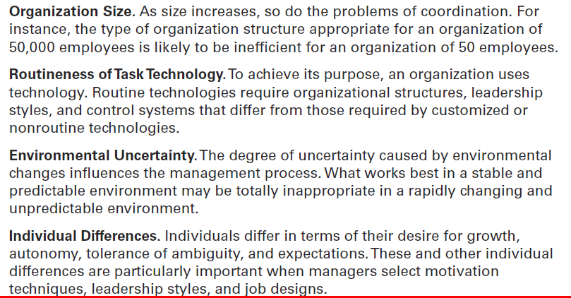
Figura HG-8 variáveis contingenciais
Notes:
Exhibit MH-8 describes four popular contingency variables. Although the list is by no means comprehensive—more than 100 different variables have been identified— it represents those most widely used and gives you an idea of what we mean by the term contingency variable. The primary value of the contingency approach is that it stresses there are no simplistic or universal rules for managers to follow.

Slide 36


